Slide 1
Fundamentals of Data Science And Analytics

Slide 2
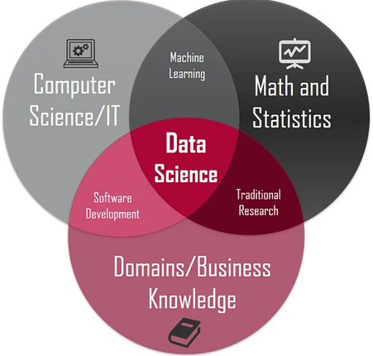
What is Data Science
Data Science is an interdisciplinary field.
It combines statistics, programming, and domain expertise.
It helps in analyzing and interpreting complex data.
Used for data-driven decision-making in businesses.
Involves collecting, processing, analyzing, and interpreting data.

Slide 3
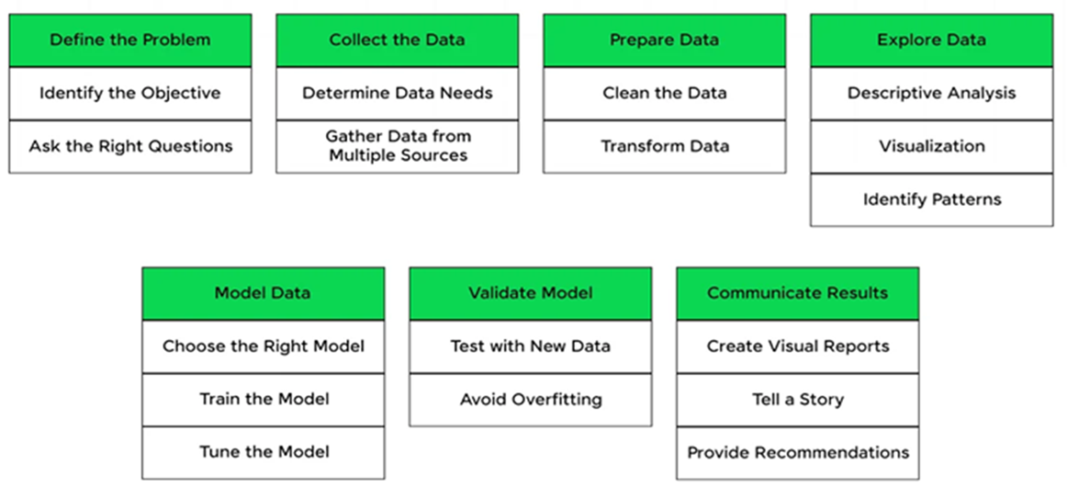
Summary for Data Science Process

Slide 4
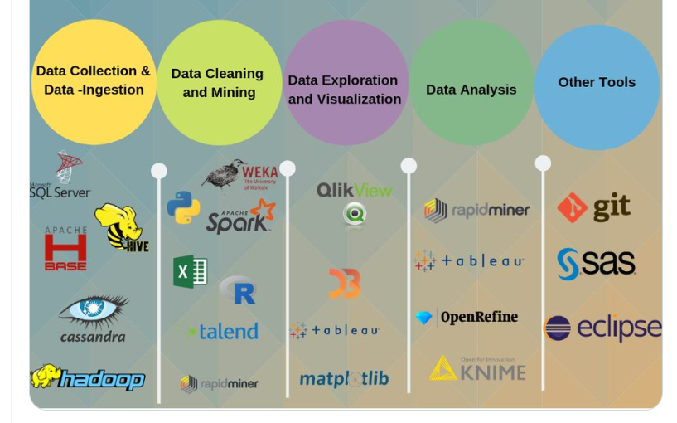
Tools And Technologies in Data Science

Slide 5
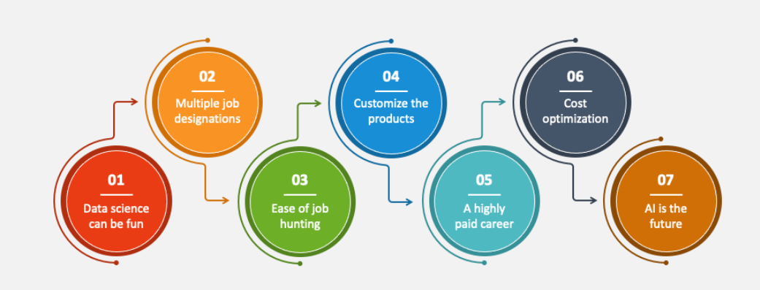
Benefits of Data Science

Slide 6
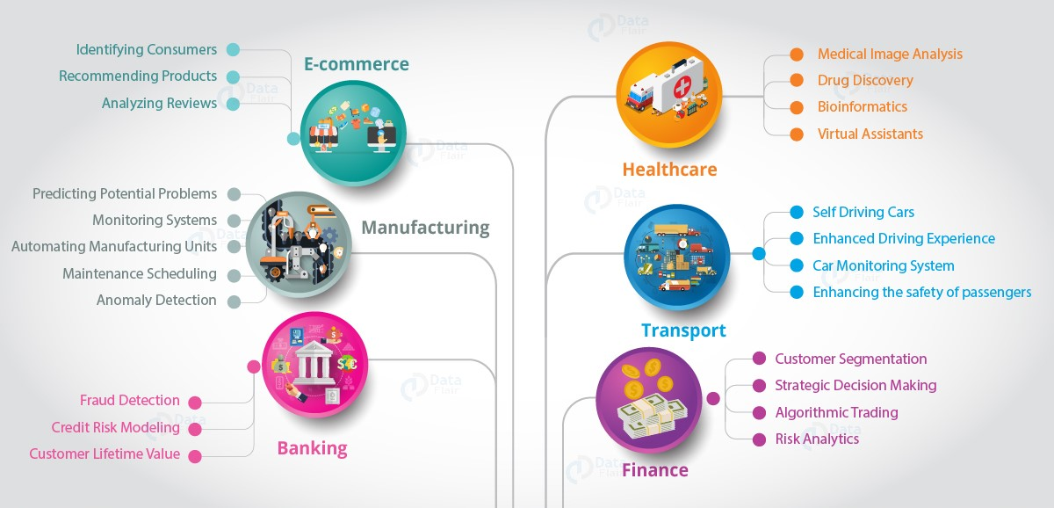
Applications of Data Science

Slide 7
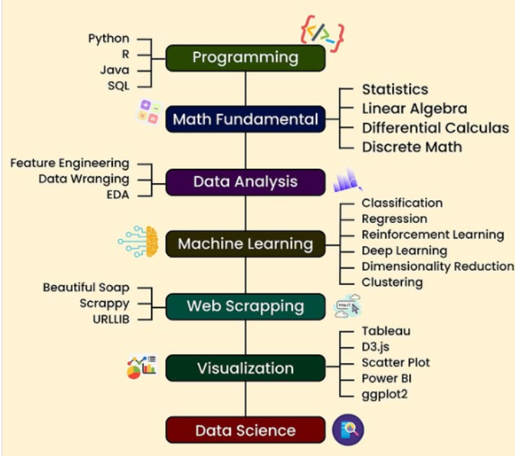
How to Becoming a Data Scientist

Slide 8
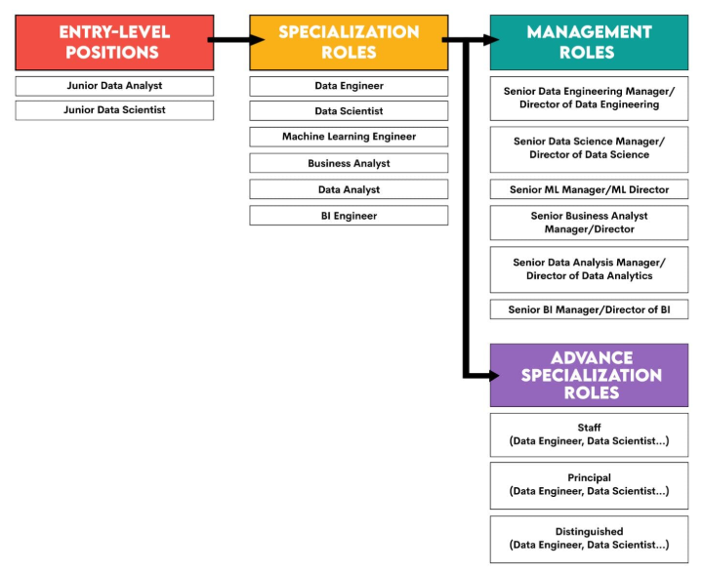
Data Science - Career Path

Slide 9
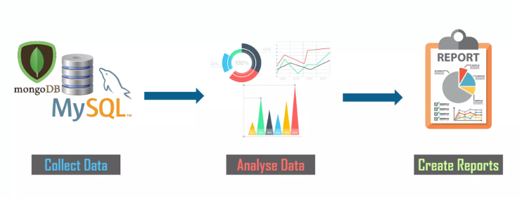
What is Data Analytics
The process of analyzing raw data to find trends, patterns, and insights for decision-making.
Why is Data Analytics Needed?
Improves Decision-Making – Helps businesses make data-driven and informed decisions.
Enhances Efficiency – Optimizes processes, reduces costs, and boosts productivity.
Identifies Trends & Risks – Detects patterns, predicts future trends, and mitigates risks.

Slide 10
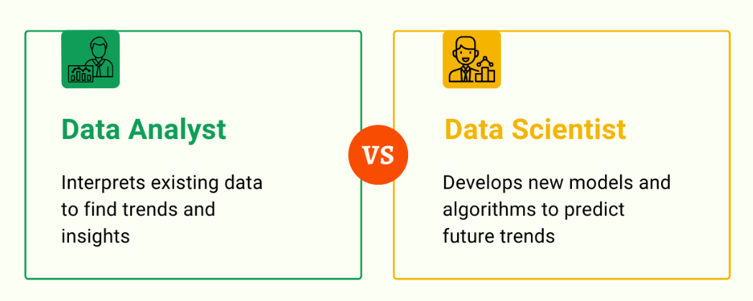
Data Analyst Vs. Data Scientist

Slide 11
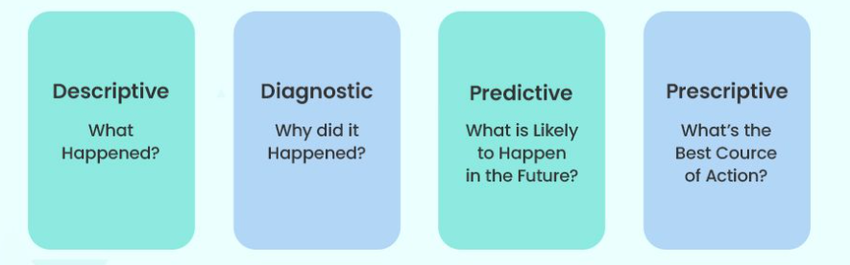
Types of Data Analytics

Slide 12
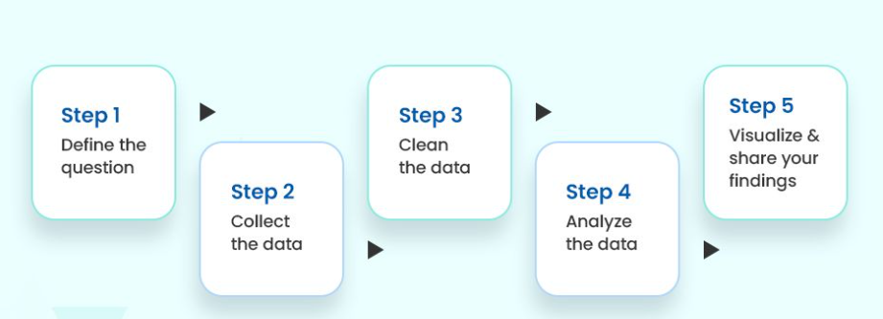
Data Analytics Process

Slide 13
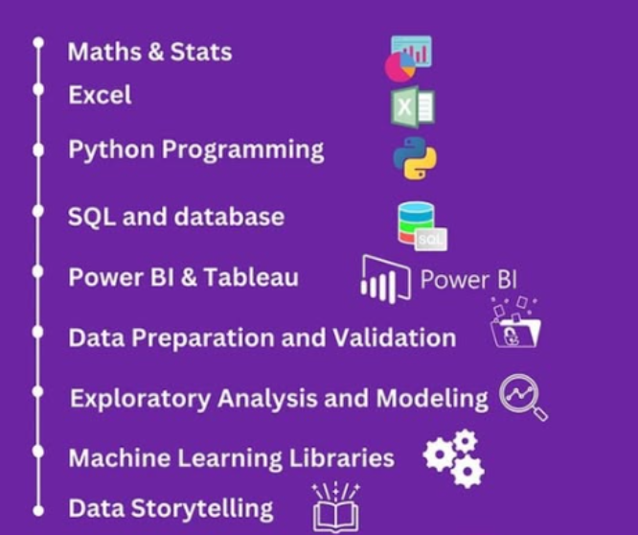
Data Analyst Road Map

Slide 14
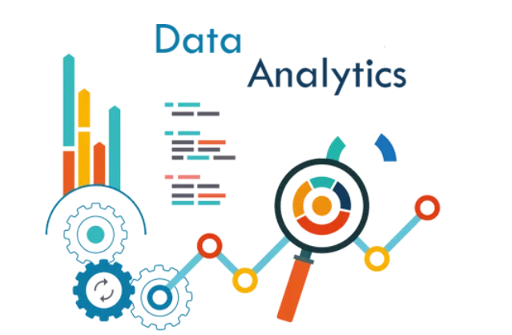
Importance of Data Analytics
Predict Customers Trends and Behaviors
Analyze,interpret and deliver data in meaningful ways.
Increase business productivity
Drive effective decision - making

Slide 15
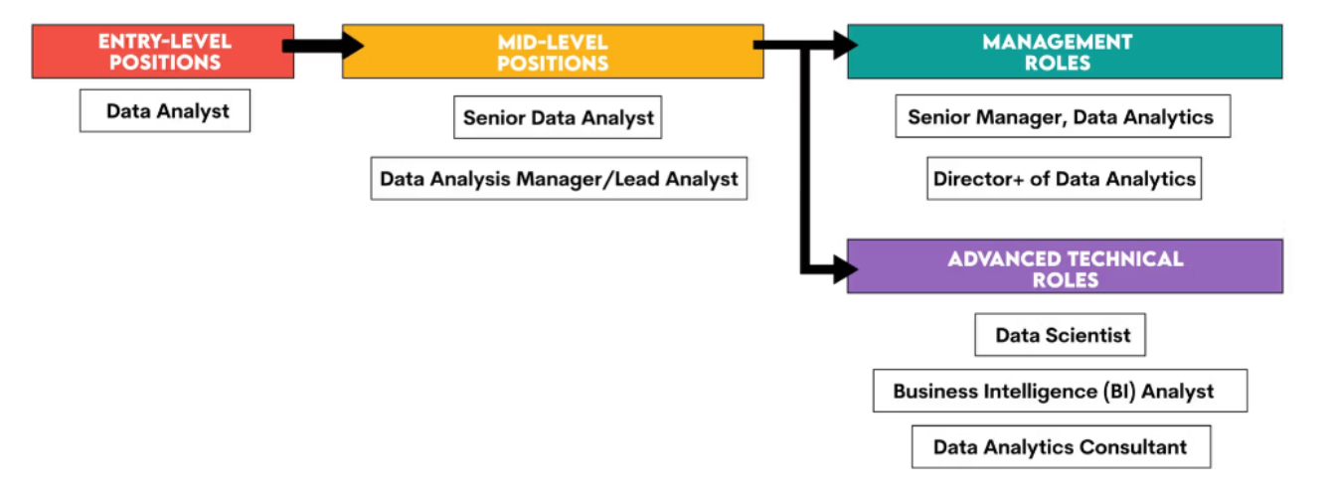
Data analyst - Career Path

Slide 16
Conclusion
Learned key concepts of data science and analytics.
Gained hands-on experience with tools like Python, SQL, and Power BI.
Explored real-world applications and industry use cases.
Understood the power of data-driven decision-making.
Encouraged to keep learning and apply skills to real projects.

Slide 17
Thank you!!!!

